Slide 1


François Pape Diouf
13/03/2025

Slide 2

Outline
Executive Summary
Introduction
Methodology
Results
Conclusion
Appendix

Slide 3
Executive Summary
Objective
The goal of this project is to analyze the cost implications of SpaceX's Falcon 9 rocket launches by developing a predictive model that determines whether the first stage will land successfully. This analysis provides insights into cost-saving opportunities and competitive benchmarking for other aerospace companies.
Methodologies
Data collection: historical Falcon9 launch records were collected from Wikipedia using web scraping. Information about launches suck as the rocket used, payload delivered, rocket specifications, landing specifications and outcome were collected from SpaceX Rest API
Data cleaning and wrangling: missing values in the PayloadMass column were imputed using mean. Landing outcomes were converted into a classification variable(1 for successful, 0 for unsuccessful)
Exploratory data analysis (EDA): data was explored using SQL, Pandas and Matplotlib. Relationships between variables such as Flight Number and Launch Site, Payload Mass and Launch Site, Orbit type and Success rate… were visualized and based on those preliminary insights, features were selected for model building. Categorical features were encoded into dummies variables and the data saved into a csv file model building.
Interactive visual analytics and Dashboard: launch sites, launch outcomes and the distance between launch sites and its proximities (city, railway, highway) were mapped
Predictive Analysis (Classification): previously processed data was load and numeric features were standardized. Data was then split into training and validation sets. We trained and tunned several machine learning models such as Logistic regression, support vector machine, decision tree and kneighbors classifier.
Results
Launch success improved with experience; the initial years (2010–2013) saw no successful missions, while post-2013 showed consistent progress. KSC LC-39A at Kennedy Space Center recorded the highest success rate (76.9%) and the most successful launches. Coastal launch sites offered strategic advantages in terms of safety and logistics. Heavy payloads exceeding 10,000 kg were associated with higher success rates, particularly for LEO, Polar, and ISS orbits, whereas the GTO orbit showed the lowest success rate with no clear link between flight number and success. ES-L1, GEO, HEO, and SSO orbits achieved a 100% success rate. On the modeling side, all tested models performed similarly on test data; however, model selection considered F1-score, ROC-AUC, and standard error, with K-Nearest Neighbors (KNN) emerging as the best-performing model.

Slide 4
Introduction
The advertisement of Falcon 9 rocket at a launch cost of $63 million by SpaceX, has revolutionized the space industry. In fact, other providers launches can exceed $165 million per launch. The main reason of this cost efficiency is the reusability of the Falcon 9 first stage. SpaceX can drastically reduce the overall cost of each launch by successfully landing and reusing the first stage.
This project objective is to develop a predictive model which will determine whether the Falcon 9 first stage will land successfully. This will help assess the cost implications of rocket launches. SpaceX but also other competitors willing to bid against SpaceX for rocket launches can gain valuable insights by understanding the factors that influence landing success.
Throughout this project, we will try to gather insights to understand the cost dynamics of rocket launches and provide strategic advantages in the competitive space industry

Slide 5

Section 1

Slide 6
Methodology
Executive Summary
Data collection methodology:
historical Falcon9 launch records were collected from Wikipedia using web scraping. Information about launches suck as the rocket used, payload delivered, rocket specifications, landing specifications and outcome were collected from SpaceX Rest API
Perform data wrangling
missing values in the PayloadMass column were imputed using mean. Landing outcomes were converted into a classification variable(1 for successful, 0 for unsuccessful)
Perform exploratory data analysis (EDA) using visualization and SQL
Perform interactive visual analytics using Folium and Plotly Dash
Perform predictive analysis using classification models
How to build, tune, evaluate classification models

Slide 7
Data Collection
historical Falcon9 launch records were collected from Wikipedia using web scraping.
Information about launches suck as the rocket used, payload delivered, rocket specifications, landing specifications and outcome were collected from SpaceX Rest API

Slide 8
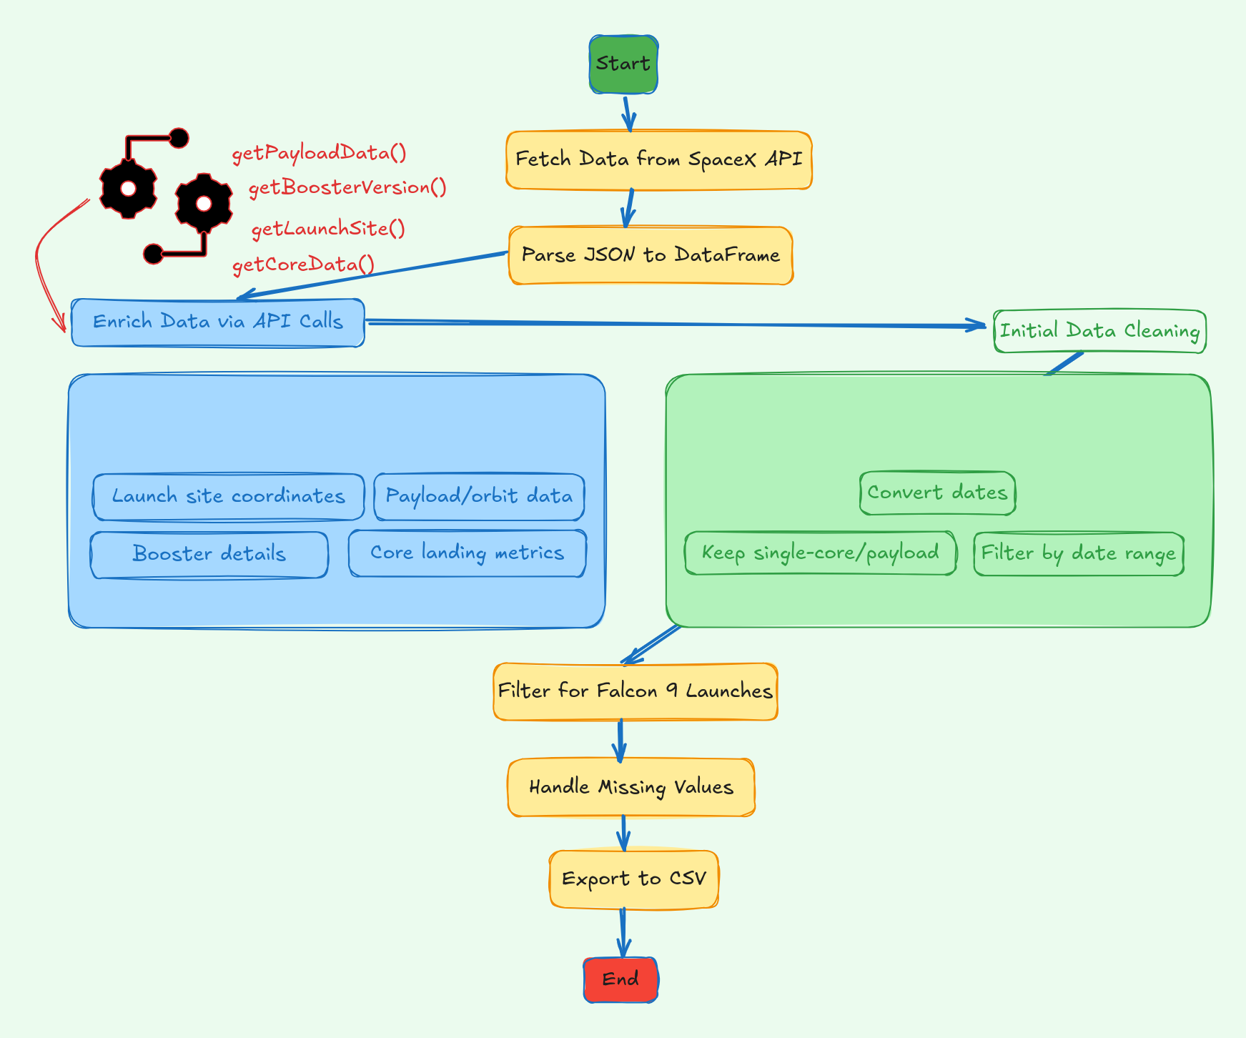
Data Collection – SpaceX API
Information about launches suck as the rocket used, payload delivered, rocket specifications, landing specifications and outcome were collected from SpaceX Rest API
https://github.com/dioufra/IBM_data_science_capstone/blob/main/jupyter-labs-spacex-data-collection-api.ipynb

Slide 9
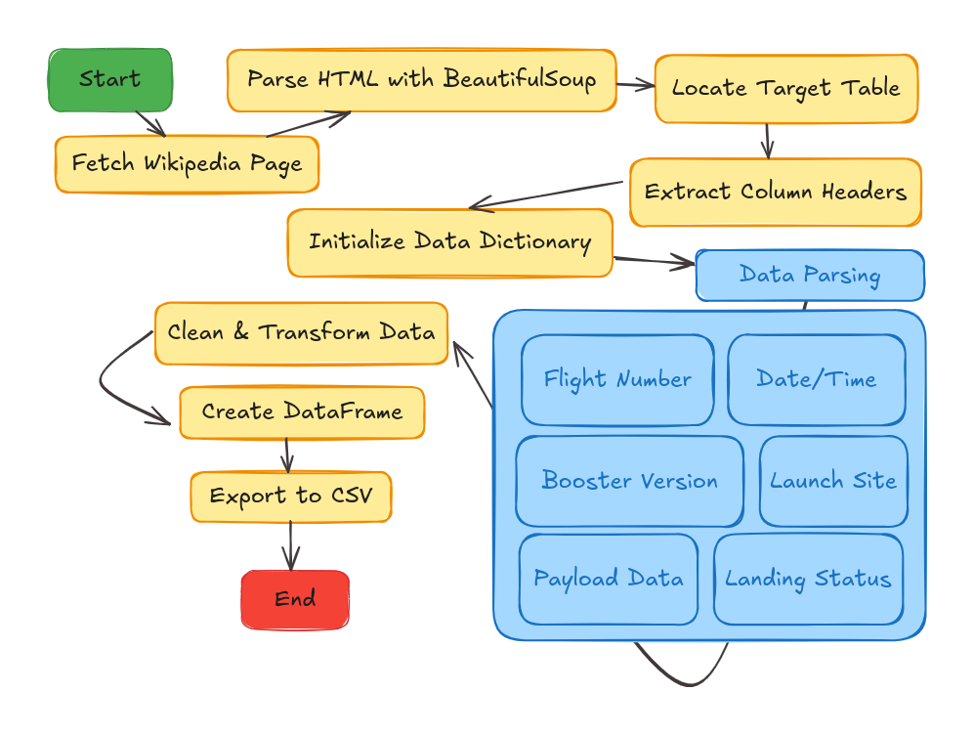
Data Collection - Scraping
Historical Falcon9 launch records were collected from Wikipedia using web scraping. The html content of the page was fetched with requests. Using BeautifulSoup, the content was parsed into a soup object. Details such as the date, the booster version, the landing status, and the payload mass were then extracted using helper functions.
https://github.com/dioufra/IBM_data_science_capstone/blob/main/jupyter-labs-webscraping.ipynb

Slide 10
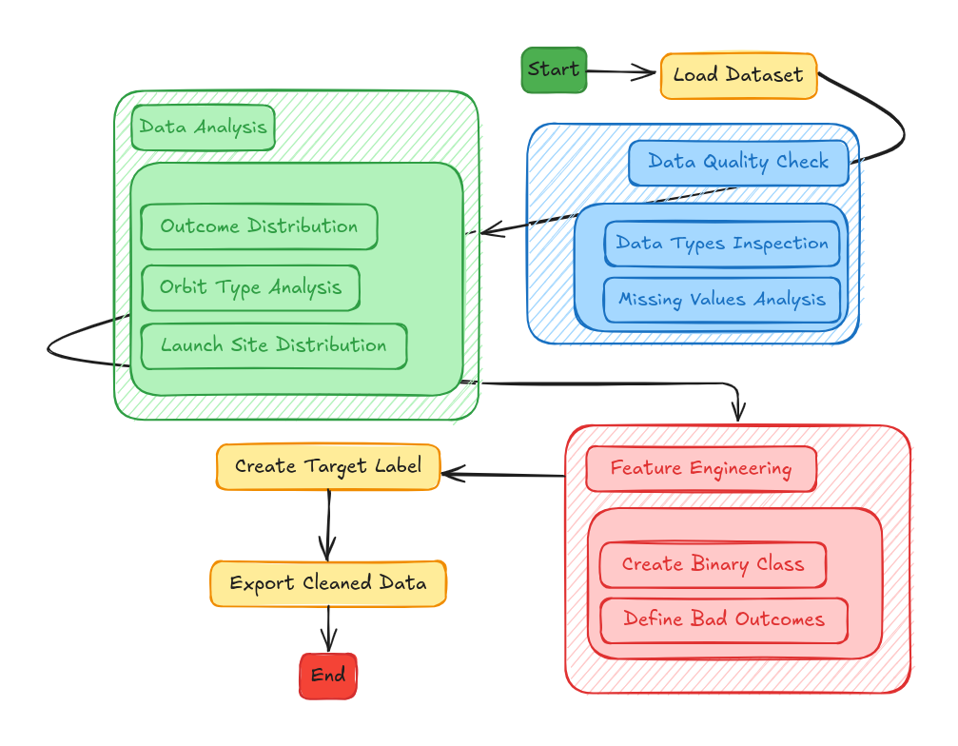
Data Wrangling
The workflow begins by loading the dataset and performing initial checks on data quality, types, and missing values. Next, feature engineering transforms outcomes into a binary classification (success/failure) with defined failure criteria, followed by the creation of a clear target variable for modeling. Finally, the cleaned data is exported in a structured format (e.g., CSV/parquet) with documented transformations, ensuring analysis-ready quality
https://github.com/dioufra/IBM_data_science_capstone/blob/main/labs-jupyter-spacex-Data%20wrangling.ipynb

Slide 11
EDA with Data Visualization
1. FlightNumber vs. PayloadMass
Type: Scatter plot (hue=Class)
Purpose: Reveal how launch attempts and payload weight correlate with success.
4. Orbit Success Rates
Type: Bar chart (mean Class by Orbit)
Purpose: Compare success rates across orbit types.
2. FlightNumber vs. LaunchSite
Type: Scatter plot (hue=Class)
Purpose: Compare success trends across launch sites over time.
5. Yearly Success Trend
Type: Line chart (Year vs. mean Class)
Purpose: Track annual improvements in landing success.
3. PayloadMass vs. LaunchSite
Type: Scatter plot (hue=Class)
Purpose: Identify payload capacity limits by site.
6. Feature Engineering
Actions: One-hot encoded Orbit, LaunchSite, and LandingPad.
https://github.com/dioufra/IBM_data_science_capstone/blob/main/edadataviz.ipynb

Slide 12
EDA with SQL
1. Unique Launch Sites
Identify all unique launch locations
6. Boosters with Drone Ship Success (Payload 4k–6k kg)
List boosters that succeeded with mid-range payloads.
2. Launch Sites Starting with 'CCA'
Filter records for Cape Canaveral sites (first 5 entries)
7. Mission Outcomes Count
Aggregate success/failure rates.
3. Total Payload Mass for NASA (CRS)
Find average payload capacity for the F9 v1.1 booster.
8. Boosters with Max Payload Mass
Identify high-capacity boosters.
4. Average Payload for F9 v1.1
Find average payload capacity for the F9 v1.1 booster.
9. 2015 Drone Ship Failures by Month
Analyze temporal trends in failures.
5. First Successful Ground Landing Date
Identify the earliest successful ground pad landing.
10. Landing Outcomes Ranking (2010–2017)
Compare landing success rates over a 7-year period.
https://github.com/dioufra/IBM_data_science_capstone/blob/main/jupyter-labs-eda-sql-coursera_sqllite.ipynb

Slide 13
Build an Interactive Map with Folium
Launch Site Markers
Added circles (radius: 1000m) and labeled markers to highlight SpaceX launch sites.
Success/Failure Visualization
Used MarkerCluster with color-coded markers (green = success, red = failure) to show launch outcomes.
Proximity Analysis
Calculated distances to coastline, highways, railways, and cities.
Added distance markers and connecting lines for spatial context.
Purpose: To analyze launch site locations, success patterns, and logistical relationships with nearby infrastructure.
https://github.com/dioufra/IBM_data_science_capstone/blob/main/lab_jupyter_launch_site_location.ipynb

Slide 14
Build a Dashboard with Plotly Dash
Why These Elements Were Added
Dropdown & Pie Chart:
Quickly compare success rates across sites
Or look into a single site’s performance.
Payload Slider & Scatter Plot:
Investigate impact of heavier payloads on success rates
And how booster versions perform.
1. Interactive Components
Dropdown Menu:
Allows selection of specific launch sites or "All Sites"
filter data dynamically.
Payload Range Slider:
Adjusts the payload mass range (0–10,000 kg)
analyze success rates by payload weight.
2. Visualizations
Pie Chart:
Shows success vs. failure rates
For all launch sites or single selected site
Scatter Plot:
Displays correlation between payload mass and launch success,
https://ds-capstone-dash-app.onrender.com/
https://github.com/dioufra/IBM_data_science_capstone/blob/main/spacex_dash_app.py

Slide 15
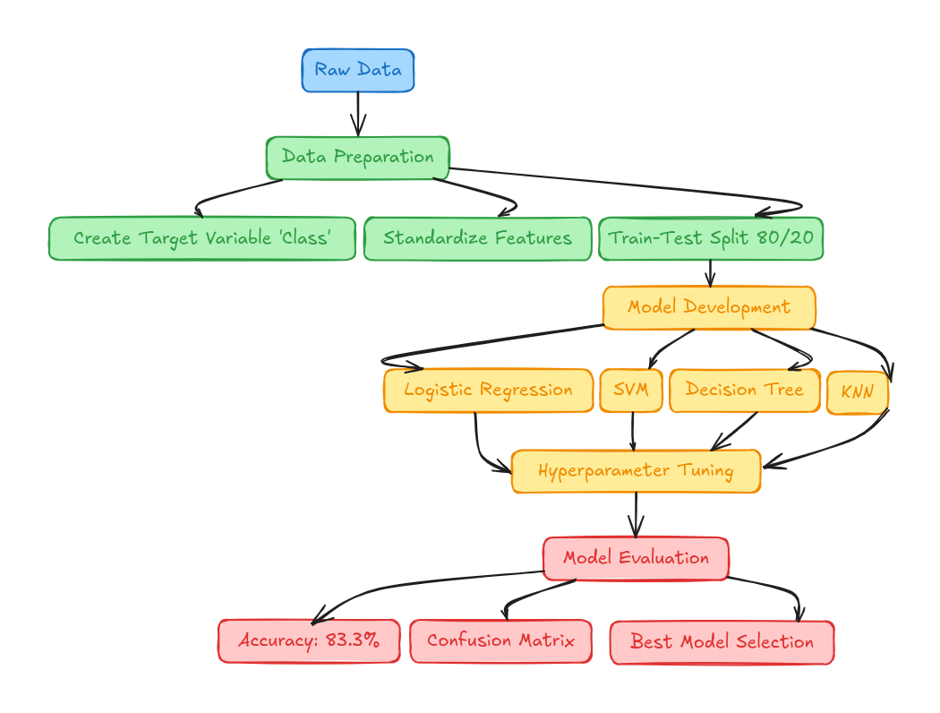
Predictive Analysis (Classification)
1. Data Preparation
Engineered binary target: Class (1=landed, 0=failed)
Standardized 18 features using StandardScaler
Split data (80% train / 20% test) with fixed random state
2. Model Development
Tested 4 algorithms with GridSearchCV (10-fold CV):
Logistic Regression
SVM (Support Vector Machine)
Decision Tree (max_depth=4, gini criterion)
KNN (K Nearest Neighbors)

Slide 16
Results
Launch Patterns & Success Rates:
Flight Experience Matters: Launch success improved with experience; initial years (2010–2013) had no successes, whereas post-2013 showed improvement.
Launch Site Insights:
LC-39A at KSC had the highest success rate (76.9%) and most successful launches.
Coastal launch sites provided safety and logistical advantages.
Payload & Orbit Effects:
Heavy payloads (>10,000 kg) had high success, especially for LEO, Polar, and ISS orbits.
GTO orbit had lowest success rate with no apparent correspondence between flight number and success.
ES-L1, GEO, HEO, and SSO orbits experienced a 100% success rate.
Modeling & Prediction:
Both models performed alike with test data.
The choice of models made use of F1-score, ROC-AUC, and Standard Error.
K-Nearest Neighbors (KNN) was ranked the best among performing models.

Slide 17

Section 2

Slide 18
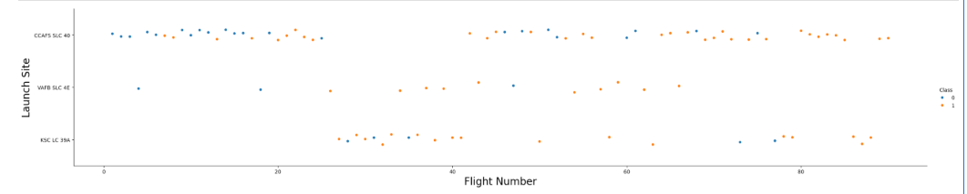
Flight Number vs. Launch Site
Description:
Relationship between Flight number and Launch site
X-axis (Flight Number): order of the flight
Y-axis (launch site).
Blue dot represents a failed missions
Yellow dot represents successful missions
Observations:
some launch sites were used more frequently than others.
As the number of flight increases, the mission outcome is likely to be successful.
It also indicates that SpaceX learned from past failures, leading to better outcomes as flight numbers increased.

Slide 19
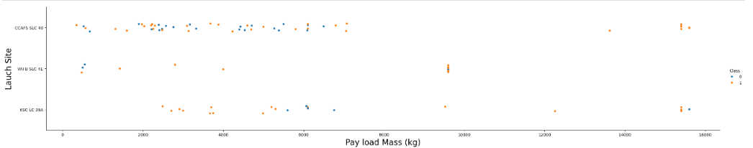
Payload vs. Launch Site
Description:
Relationship between Payload mass Launch site
X-axis (Payload mass): mass of the payload
Y-axis (launch site).
Blue dot represents a failed missions
Yellow dot represents successful missions
Observations:
Almost all rockets launched for heavy payload mass were successful
there are no rockets launched for heavy payload mass(greater than 10000) for VAFB-SLC

Slide 20
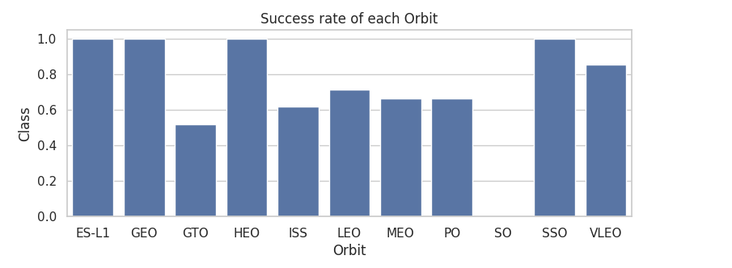
Success Rate vs. Orbit Type
Description:
Success rate of each obit
X-axis (Orbit): orbits (LEO, ISS, GTO, ....), destination of each mission.
Observations:
ES-L1, GEO, HEO and SSO orbits have the highest success rate (1)
ISS, MEO, LEO, PO show a moderate success rate between 0.6 and 0,7
GTO has the lowest success

Slide 21
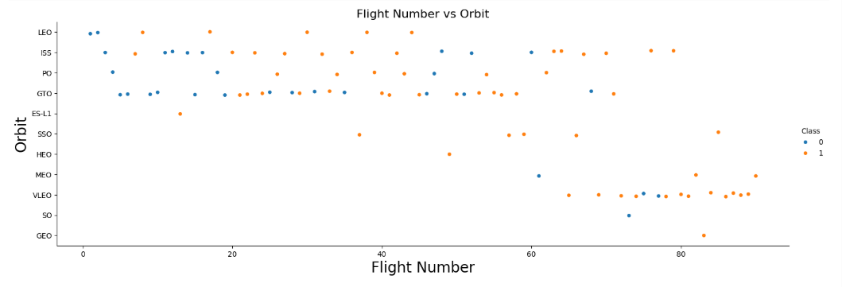
Flight Number vs. Orbit Type
Description:
Relationship between flight number and Orbit
X-axis (Flight Number): order in which missions were launched.
Y-axis (Orbit): orbits (LEO, ISS, GTO, ....), destination of each mission.
Blue dot represents a failed missions
Yellow dot represents successful missions
Observations:
LEO orbit, success seems to be related to the number of flights.
in the GTO orbit, there appears to be no relationship between flight number and success.

Slide 22
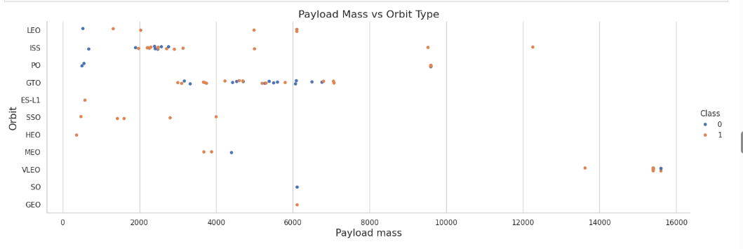
Payload vs. Orbit Type
Description:
Relationship between Payload Mass vs Orbit Type
X-axis (Payload mass): mass of the payload
Y-axis (Orbit): orbits (LEO, ISS, GTO, ....), destination of each mission.
Blue dot represents a failed missions
Yellow dot represents successful missions
Observations:
heavy payloads the successful landing are more for Polar,LEO and ISS.
GTO, it's difficult to distinguish between successful and unsuccessful landings as both outcomes are present.

Slide 23
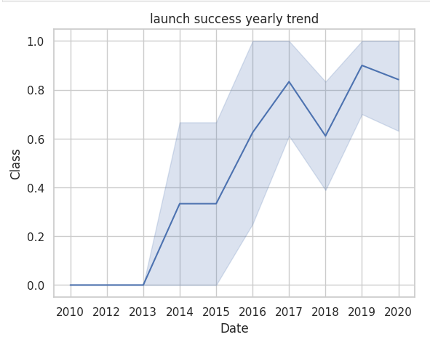
Launch Success Yearly Trend
This line plot shows the trend of launch success rates over time from 2010 to 2020, with an associated confidence interval (shaded area).
Axes and Labels:
X-axis (Date): Represents the years from 2010 to 2020.
Y-axis (Class): Represents the success rate of launches, ranging from 0 (no success) to 1 (100% success rate).
Shaded Region: Represents the confidence interval, showing variability in success rates.
Observations:
Early Years (2010 - 2013):
No successful launches (success rate = 0).
2013 - 2020:
success rate kept increasing

Slide 24
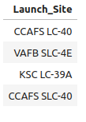
All Launch Site Names
This SQL query retrieves the unique launch sites used in space missions from the SPACEXTABLE database.
Four unique launch sites are identified:
CCAFS LC-40
VAFB SLC-4E
KSC LC-39A
CCAFS SLC-40
The objectif of this analysis was to identify where spaceX missions are launched from

Slide 25
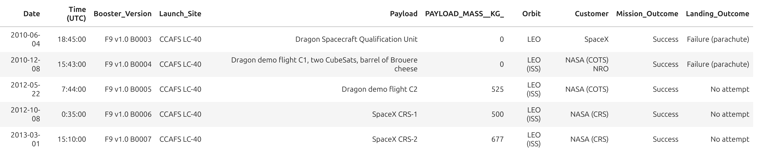
Launch Site Names Begin with 'CCA'
This SQL query retrieves distinct rows from the SPACEXTABLE where the Launch_Site name starts with 'CCA', limited to 5 records.

Slide 26
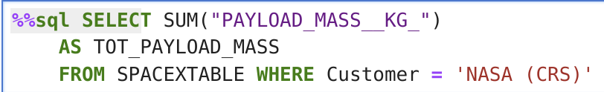
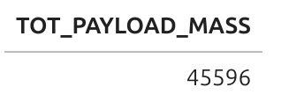
Total Payload Mass
The SQL query calculates the sum of the PAYLOAD_MASS_KG column for all records where the Customer is 'NASA (CRS)'.
The query result shows that the total payload mass carried by SpaceX boosters for NASA (CRS) missions is 45,596 kg.
This indicates that SpaceX has transported a significant amount of cargo (over 45 metric tons) to support NASA's missions

Slide 27
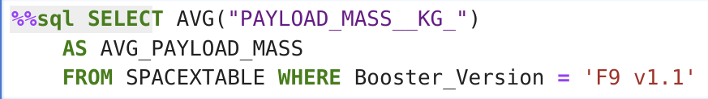
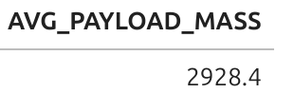
Average Payload Mass by F9 v1.1
The SQL query calculates the average of the PAYLOAD_MASS_KG column for all records where where the Booster_Version is 'F9 v1.1'.
This suggests that the F9 v1.1 had an average payload capacity of approximately 2.93 metric tons per mission.

Slide 28
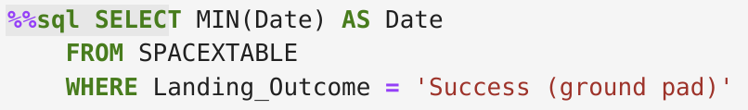
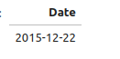
First Successful Ground Landing Date
The SQL query retrieves the minimum (oldest) date (MIN(Date)) from the SPACEXTABLE where the Landing_Outcome was 'Success (ground pad)'.
The result is labeled as Date and marks a historic milestone in SpaceX's reusable rocket technology
The query result shows that the earliest successful ground pad landing of a SpaceX booster occurred on December 22, 2015.
The query result shows that the earliest successful ground pad landing of a SpaceX booster occurred on December 22, 2015.

Slide 29
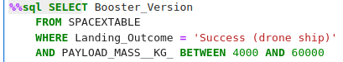
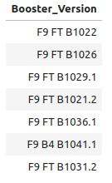
Successful Drone Ship Landing with Payload between 4000 and 6000
The query result lists the booster versions that successfully landed on a drone ship and carried a payload mass between 4,000 kg and 60,000 kg.
The results show 7 boosters:
F9 FT B1022
F9 FT B1026
F9 FT B1029.1
F9 FT B1021.2
F9 FT B1036.1
F9 B4 B1041.1
F9 FT B1031.2

Slide 30
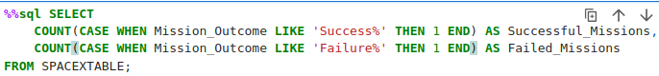
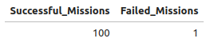
Total Number of Successful and Failure Mission Outcomes
The query counts:
Successful_Missions: Records where Mission_Outcome starts with "Success".
Failed_Missions: Records where Mission_Outcome starts with "Failure".
Success Rate: 100 out of 101 missions were successful, indicating a 99% success rate.
Failure Rate: Only 1 failure was recorded, demonstrating SpaceX's high reliability.

Slide 31
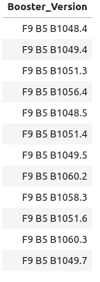
Boosters Carried Maximum Payload
The query uses a subquery to first find the maximum payload mass (MAX(PAYLOAD_MASS_KG)) in the table, then lists all boosters that carried that exact mass. The results highlight SpaceX's ability to repeatedly launch heavy payloads with reused boosters, a cornerstone of their cost-effective model.
The results can be seen in the picture

Slide 32
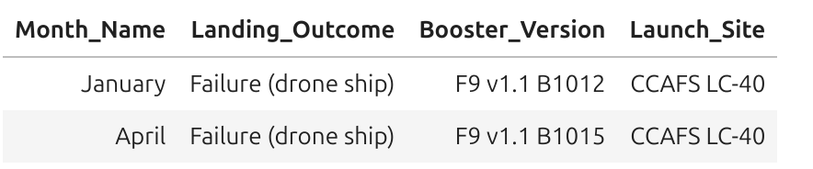
2015 Launch Records
The table shows two failed drone ship landing attempts involving early versions of SpaceX's Falcon 9 boosters:
January Failure:
Booster: F9 v1.1 B1012
Launch Site: CCAFS LC-40 (Cape Canaveral)
Outcome: Failed to land on the drone ship.
April Failure:
Booster: F9 v1.1 B1015
Launch Site: CCAFS LC-40
Outcome: Another drone ship landing failure.

Slide 33
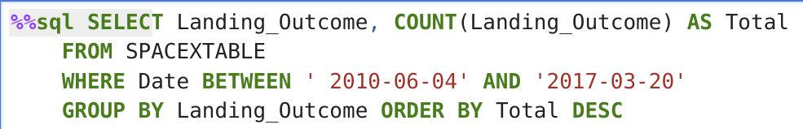
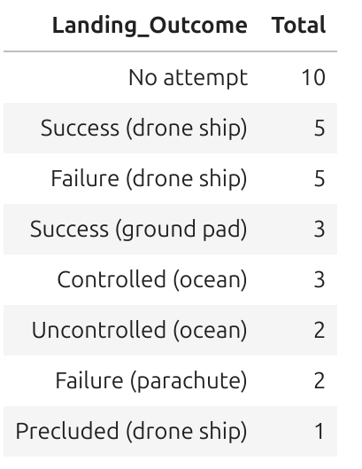
Rank Landing Outcomes Between 2010-06-04 and 2017-03-20
This query rank the count of landing outcomes (such as Failure (drone ship) or Success (ground pad)) between the date 2010-06-04 and 2017-03-20, in descending order

Slide 34

Section 3

Slide 35
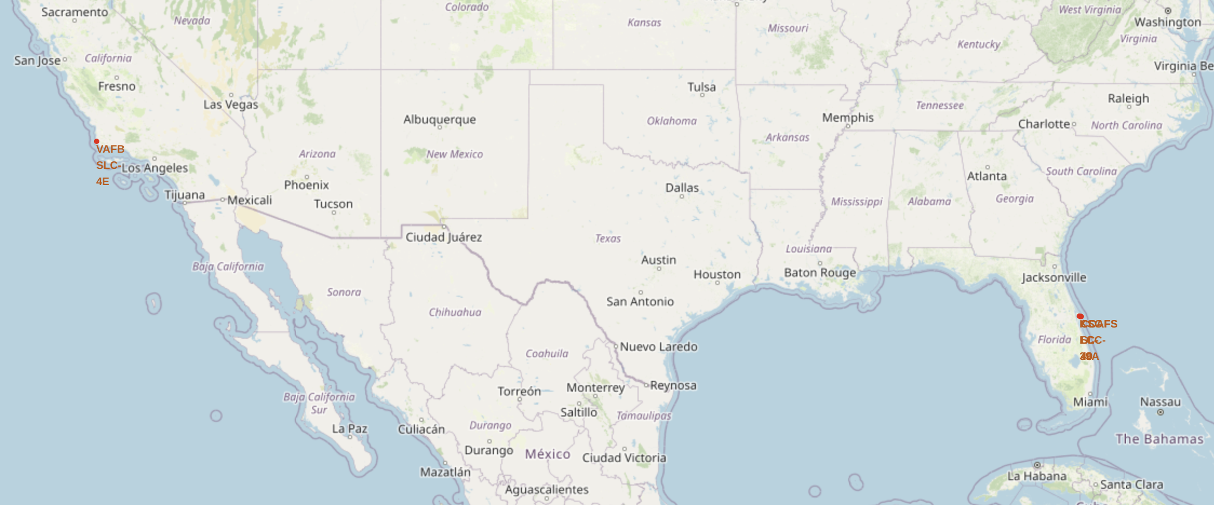
Launch Sites Locations
SpaceX priorities proximity to coastal zone than equator line
Ocean trajectories minimize risk to populated areas.
Enables controlled water landings for failed launches.

Slide 36
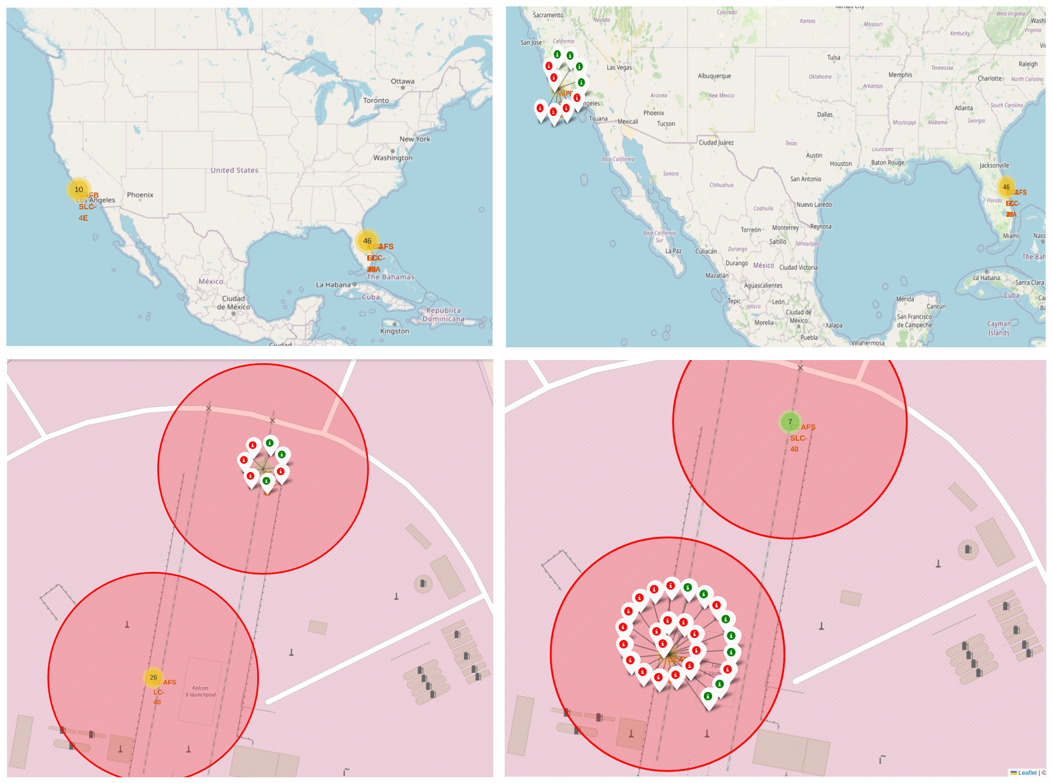
Launch Site Outcomes
Key Findings & Elements:
Success/Failure Distribution – High-success regions (e.g., Cape Canaveral) contrast with sites showing frequent failures, suggesting correlations with infrastructure or operational factors.
Geographic Clusters – Launch sites near equatorial zones (e.g., Kourou) exhibit higher success rates, likely due to favorable orbital mechanics.
Outlier Patterns – Isolated failure clusters may indicate site-specific risks (weather, technology).
Insight: The map highlights the impact of location on launch outcomes, supporting data-driven site selection for future missions.

Slide 37
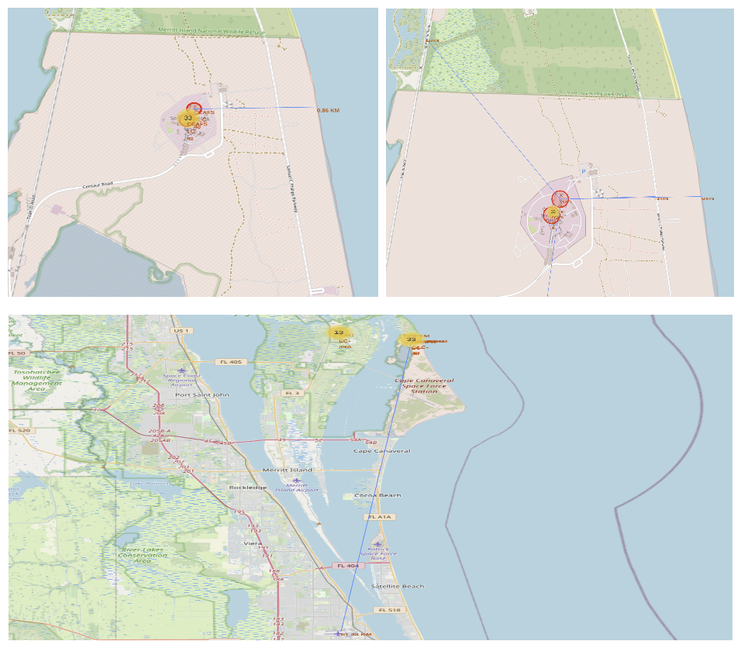
Launch Sites Proximities
Key Criteria for Launch Site Location
Near Coastline:
Safe launch trajectory over the ocean
Enables emergency water landings
Limits risk to people and infrastructure
Near Highways: Simplifies movement of personnel and equipment.
Near Railways: Essential for transporting large and heavy components.
Far from Cities: Reduces danger to densely populated areas in case of failure.

Slide 38

Section 4

Slide 39
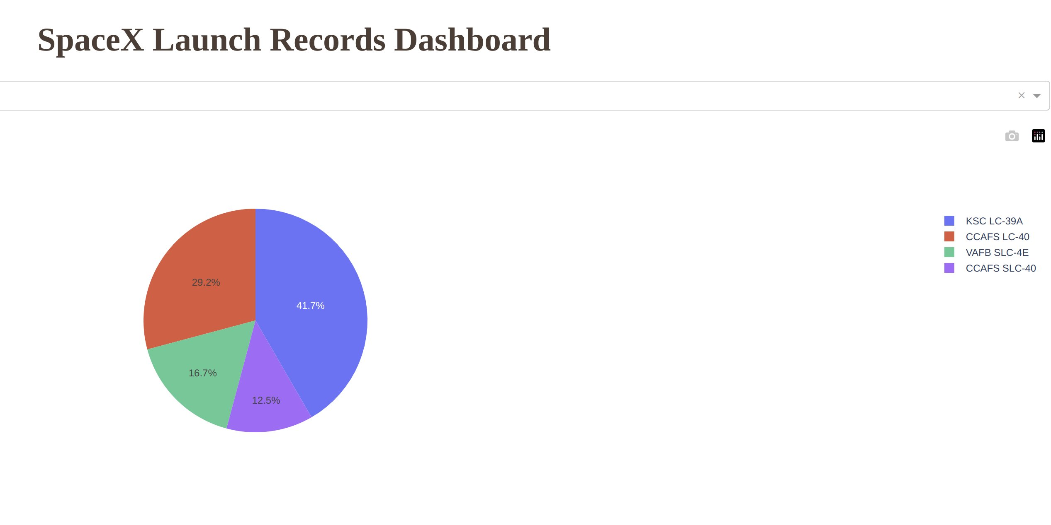
Launch Sites Success Rate
KSC LC-39A launch site has the highest number of successful launches.
CCAFS LC-40 followed with a percentage of 29.2 %
VAFB SLC-4E and CCAFS SLC-40 account for a smaller portions with 16.7% and 12.5% respectively.

Slide 40
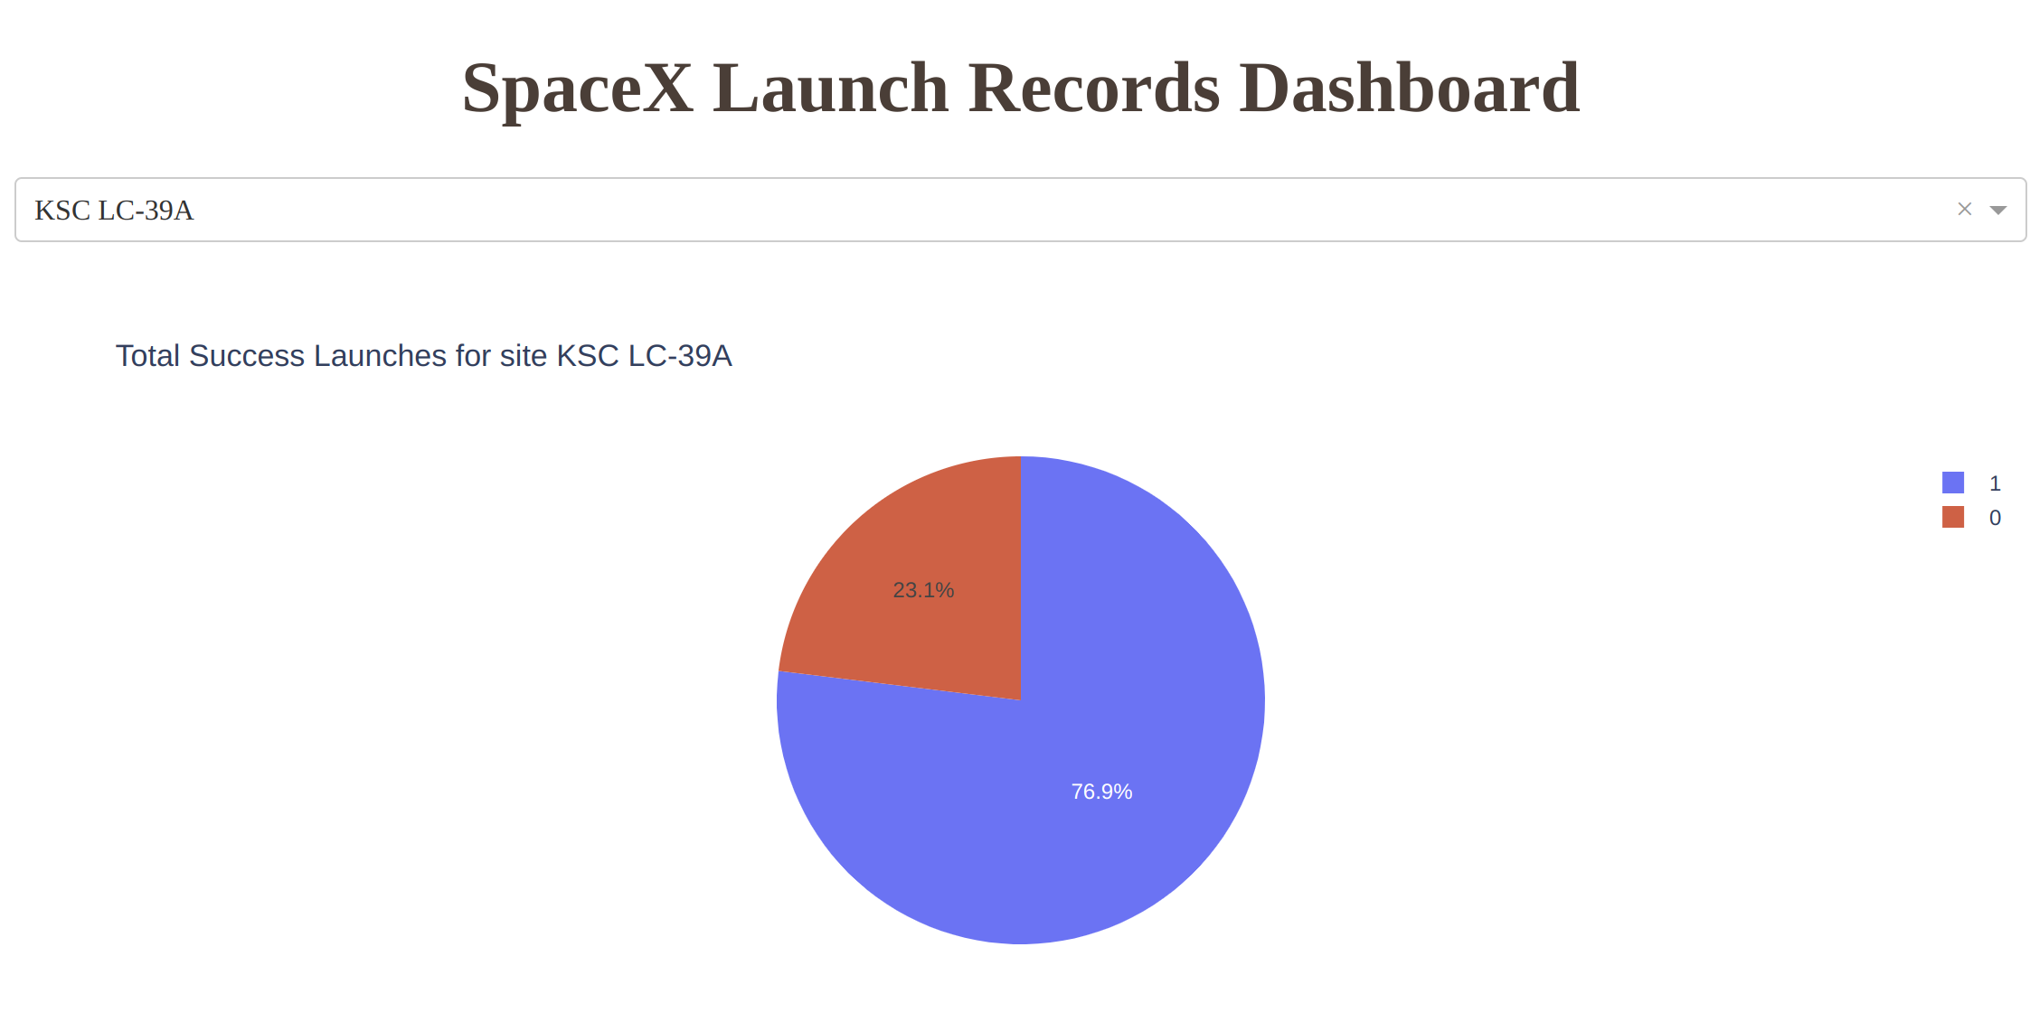
KSC LC-39 Launch Site Success Rate
The dashboard reports launch success rates at the KSC LC-39A facility, a launch complex at NASA's Kennedy Space Center used by SpaceX.
The pie chart shows the percentage of successful (1) and failed (0) launches at the facility.
76.9% of the launches succeeded, with 23.1% failing, representing a reasonably high success rate but one which could be improved.

Slide 41
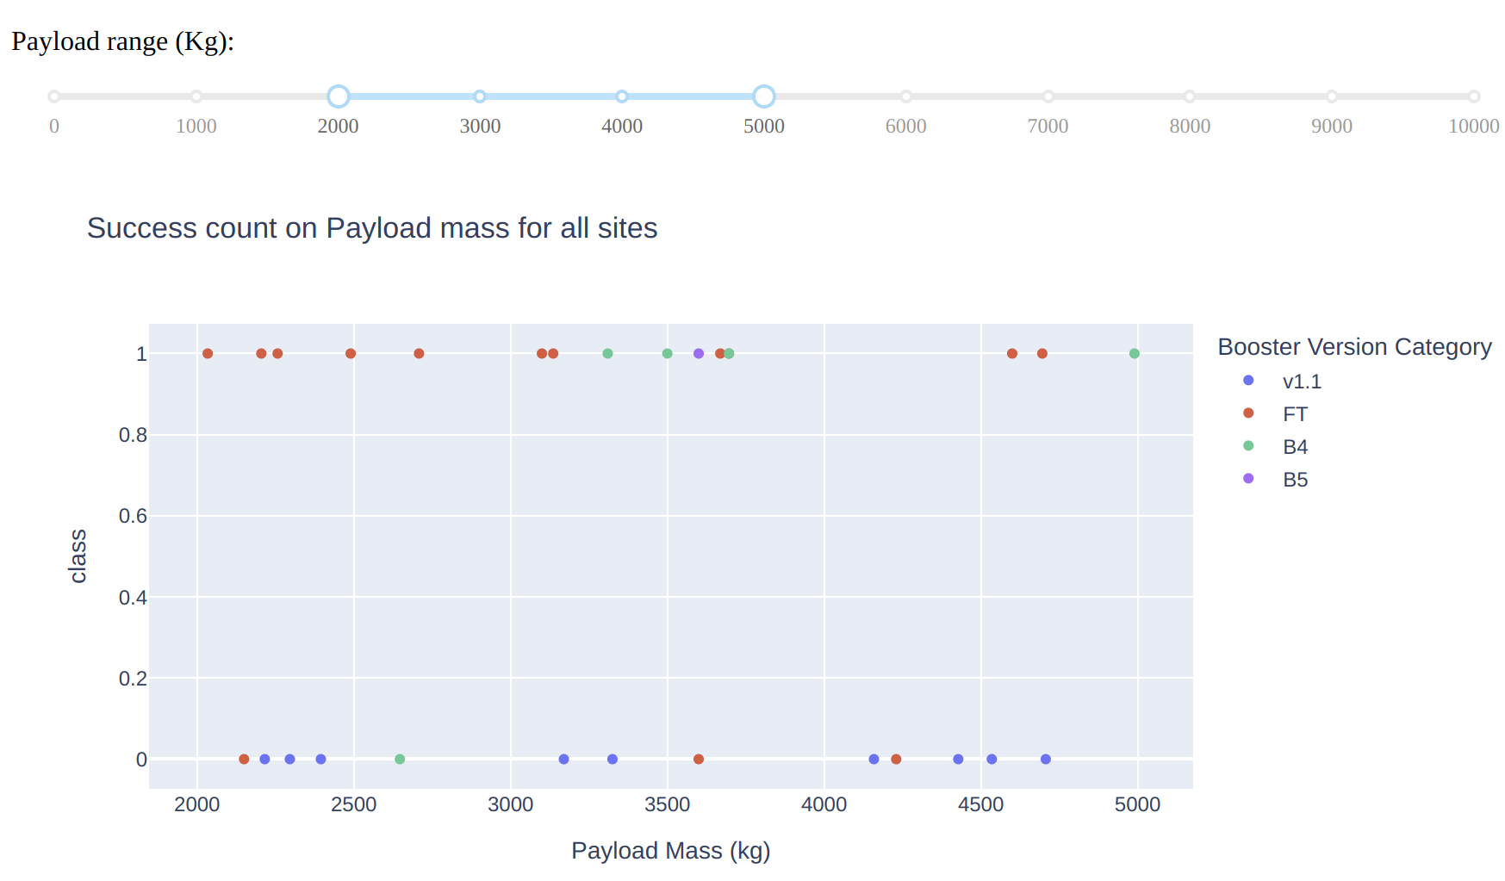
Payload vs. Launch Outcome
Successes (y = 1) are dispersed across all payload ranges, but failures (y = 0) are more frequent with v1.1 and FT versions, especially in the 2000–4500 kg range.
Subsequent booster versions like B4 and B5 have better success rates, even at heavier payloads, indicating increased reliability over time.

Slide 42

Section 5

Slide 43
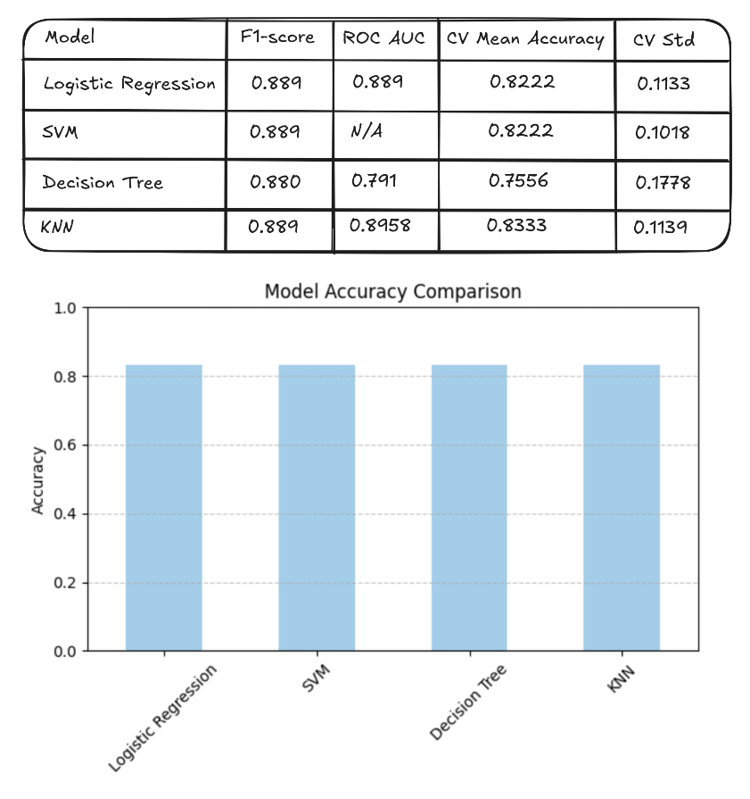
Classification Accuracy
All the modest have the same accuracy of the test data
For model selection different other metrics were used such as f1-score roc-auc. The standard error was also assessed.
Based on the results KNN was selected as a best performing model

Slide 44
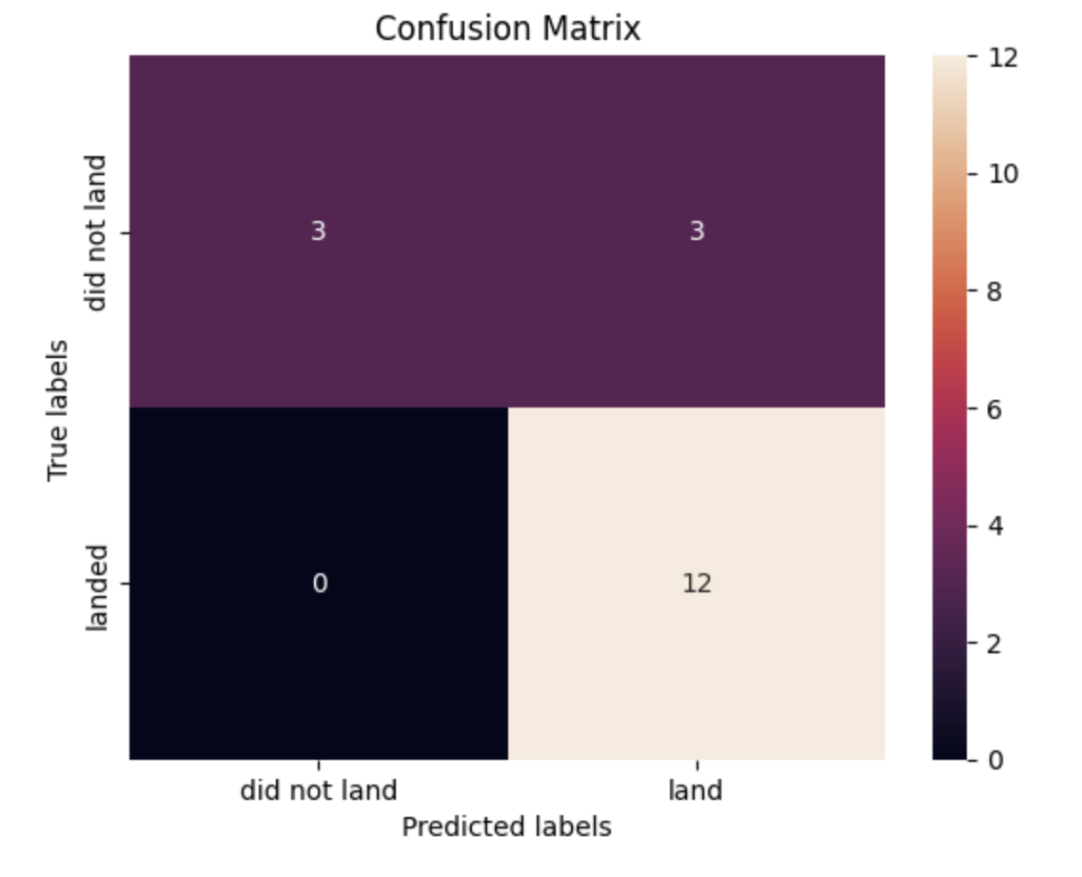
Confusion Matrix
The confusion matrix shows how well the classifier performed in predicting rocket landings. Out of 18 samples:
12 successful landings were correctly predicted.
3 failures were also correctly predicted.
3 failures were mistakenly classified as successful landings.
No successful landings were misclassified as failures
This suggests the model is reliable for detecting successful landings

Slide 45
Conclusions
Launch Patterns & Success Rates:
Flight Experience Matters: Launch success improved with experience; initial years (2010–2013) had no successes, whereas post-2013 showed improvement.
Launch Site Insights:
LC-39A at KSC had the highest success rate (76.9%) and most successful launches.
Coastal launch sites provided safety and logistical advantages.
Payload & Orbit Effects:
Heavy payloads (>10,000 kg) had high success, especially for LEO, Polar, and ISS orbits.
GTO orbit had lowest success rate with no apparent correspondence between flight number and success.
ES-L1, GEO, HEO, and SSO orbits experienced a 100% success rate.
Modeling & Prediction:
Both models performed alike with test data.
The choice of models made use of F1-score, ROC-AUC, and Standard Error.
K-Nearest Neighbors (KNN) was ranked the best among performing models.

Slide 46
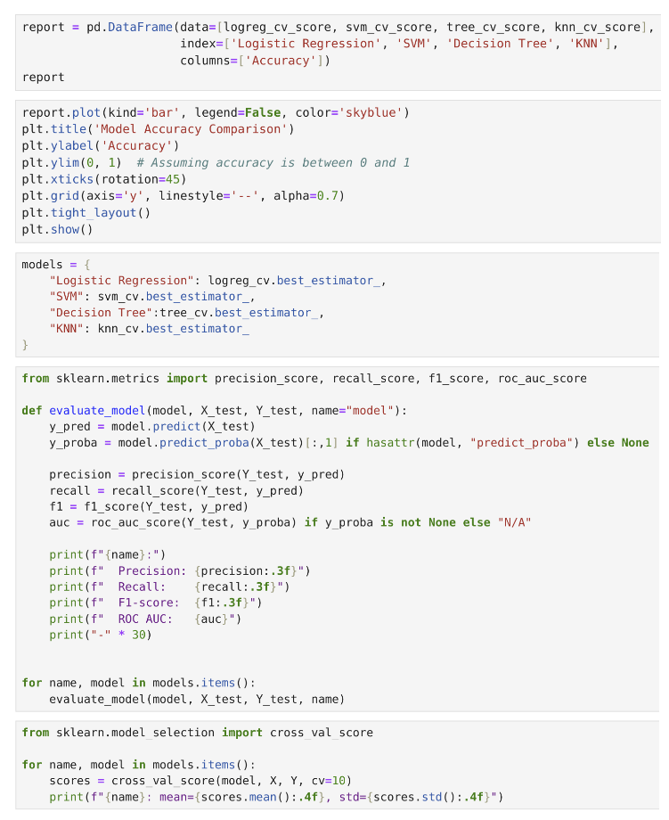
Appendix
Code snippets used to select best performing model

Slide 47


